Slide 1
Session 3:
Major topics from ECC Strategic Plan
Numbering & Networks
Freddie McBride, European Communications Office
4th CEPT workshop on “European Spectrum Management and Numbering”
ECO, 5 April 2016
Notes:
Ladies and Gentelemen – Pleasure and privilege
My name is, eco. Tell you more
I want you to consider my presentation as food for thought in terms of the future development of NP systems.
The way consumers purchase and consume communications services is changing. Namely bundling.
These changes will have a fundamental impact on the future development of national telehone numbering plans and management o that resource. Consequently, NP systems, processes and procedures will be affected also.
Until now, NP has been a vary successful competition enabler. It needs to remain so in the new environment.

Slide 2
Numbering and Networks

Slide 3
ECC Strategic Plan – Major topics for the next 5 years
Migration from legacy networks to Next Generation Networks (all-IP)
The transition from circuit-switched to packet switched communication and from electrical to optical transmission is ongoing and many operators around Europe will make this migration in both core and access networks during the next strategic cycle. These changes could have implications on how electronic communications networks and services will be provided in the future and new policies and guidelines will be required.
The ECC shall, through the development of appropriate deliverables, ensure that the regulatory principles of competition, consumer choice and innovation are protected when the transition to Next Generation Networks occurs

Slide 4
Predicting “speed of evolution” and “legacy phase out” Key events in the last 20 years
Mid-late 1990s – market liberalisation, growth of mobile and internet creates massive investor appetite in telecoms – ”irrational exuberence”. eBay, Amazon and PayPal founded.
1999-2000– Billions in revenue generated on the sale of 3G licenses in Europe. Windfall for governments but probably pushed back investment in 3G by 5 years.
2001-2002– dot.com bubble bursts wiping more than $5 trillion off the value of technology companies. Huge negative impact on vendors and operators. Investment capital for telecoms applications, service and networks dries up.
2002-2006 – Leading social media companies founded. Then only really desktop applications but, in hindsight, timing was just right. Breakthroughs in handset developments, GPS, cameras etc.
2006 - DOCSIS 3.0 released. - Enabled cable TV operators to provide 15mbps broadband over co-ax. First triple play products emerge. Incumbents left with no choice but to invest in advanced copper and fibre access networks.
2007 – First iphone launched - start of virtuous cycle of growth and social media revolution. First Kindle launched.

Slide 5
Predicting “speed of evolution” and “legacy phase out” Key events in the last 20 years
2008-2009 Financial crisis. – Not all bad for telecoms. European economies refocus on smart/knowledge/digital economy. Airbnb and Uber founded.
2009-2010– First ipad released and nicely timed with the proliferation of wifi hotspots. Viber, Instagram and WhatsApp created.
2012– 2015 Digital Dividend, LTE/4G and multi band spectrum auctions to support demand for growth in mobile data. Continued investments in fibre and beginning of IMS rollout in Europe. OTT on mobile. Growth in FinTech
2015 – 2022?
- Growth in M2M, IoT, cloud services
- Wearables - nearly 84 million in 2015. 245 million by 2019
- Wide scale IMS rollout in Europe towards an all-IP end state
................. or another tech bubble?
Company | Cap Rank
Apple | 1
Google | 2
Microsoft | 3

Slide 6
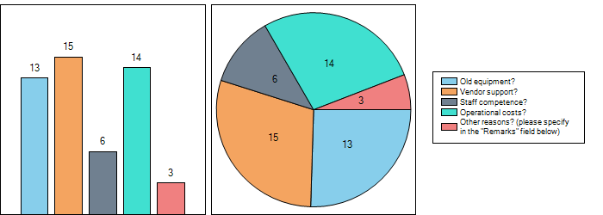
Expectations and speed of migration to All-IP
Expectations of the end-user (early adopters to laggards)
- some users expect faster speeds and greater choice of services
- some users are happy with a quality voice service
Expectations of operators
- return on investment
- customer retention
- cost reduction
Expectations of OTT players (greater bandwidth)
- greater bandwidth and coverage means more people to view ads
Expectations of regulators
- universal service obligations, competition, innovation
- access to emergency services and provision of caller location information
- lawful interception
- quality of service and security

Slide 7
The roadmap to All-IP
Networks
Consolidatedd numbering ranges (P2P, M2M)
Numbering
Numbering silos
Period of Flux!
Notes:
This is an adaptation of a slide from TDC in a presentation to PT TRIS in March earlier this year. TDC consider 3 phases on the road to all-IP. I have added the numbering section at the bottom which highlights a correspodning evolution in numbering. Of course, when we look at evolution internally we predict based on trends in technology, consumer preferences, regulation etc but the speed of evolution can be dictated by looking back and seeing how external factors have influenced the speed of evolution in the past.

Slide 8
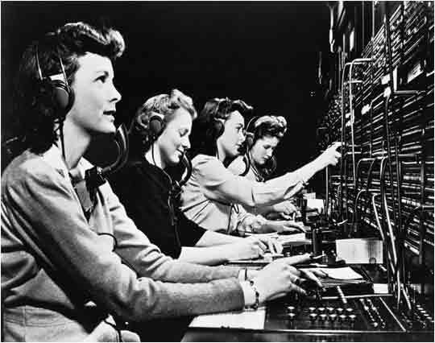
Origin of telephone numbers
The use of telephone numbers instead of subscriber names to indicate to the telephone operator what destination line a caller wished to be connected to was developed and first used in the autumn of 1879 in Lowell, Massachusetts during a measles epidemic. Moses Greeley Parker, a local doctor, realized that if all four of the city's operators were incapacitated by the epidemic, their replacements would have great trouble quickly learning which of the switchboard's 200 jacks were assigned to which subscribers. He recommended the use of numbers instead.

Slide 9
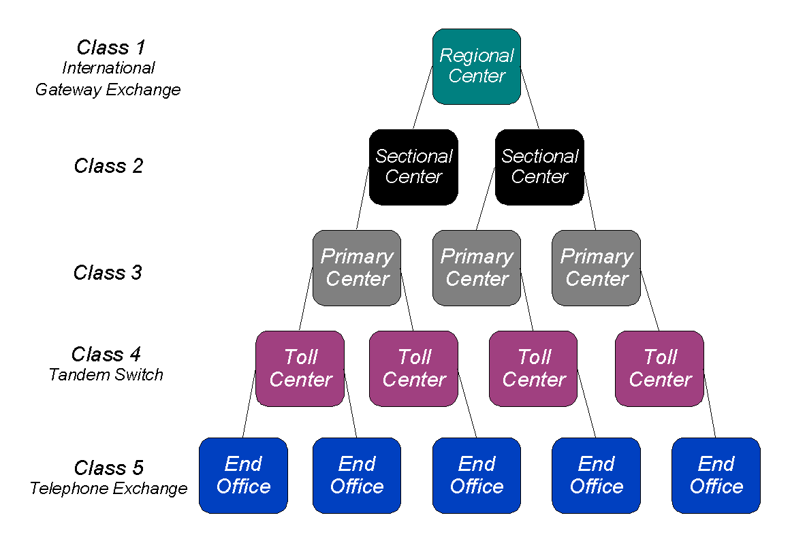
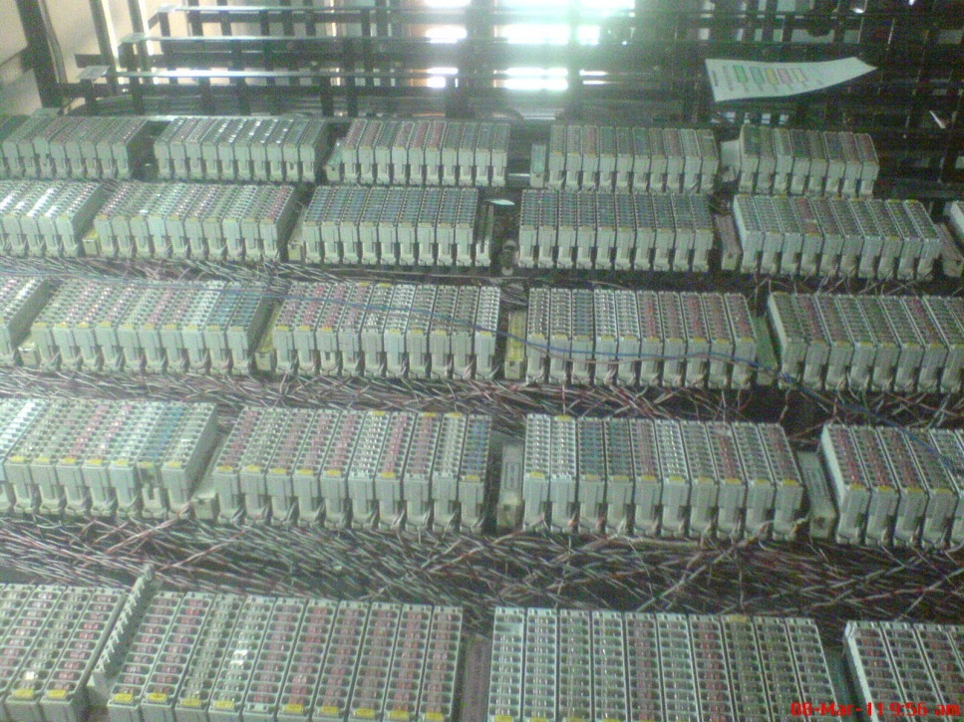
Evolution to direct dialling

Slide 10
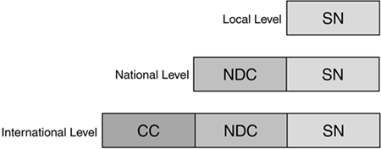
ITU-T E.164
Country Codes – Denmark +45, UK +44, Ireland +353
Assigned to national ministries
Behind the country code, the management and configuration of the numbering scheme is a national matter
Some elements of harmonisation particularly in Europe – 112, 116, 118 for example

Slide 11
Management of Numbering & Identifiers
Internet World
Traditional Telecoms World
Resources assigned to Administrations
by ITU-T
INR assigned direct
to operators by ITU-T
Other resources
assigned by ITU-T
E.164 CC
E.212 MCC
UIFN (E.169.1)
ICC (M.1400)
Non-ITU resources
assigned by other entities
Resources assigned by Administrations
to service providers at the National level
UIPRN (E.169.2)
Terminal (T.35)
IC (E.164.3)
Bureaufax (F.170)
IMEI (3GPP TS 23.003)
ISCN (E.169.3)
Domain name (RFC 1034)
Telephone numbers (E.164)
MNC (E.212)
Shared MNC (E.212)
IPv4-address (RFC 791)
ISPC/NSPC (Q.708)
Trials (E.164.2)
IPv6-address (RFC 2460)
MAC (ISO 8802.3)
Legacy Resources

Slide 12
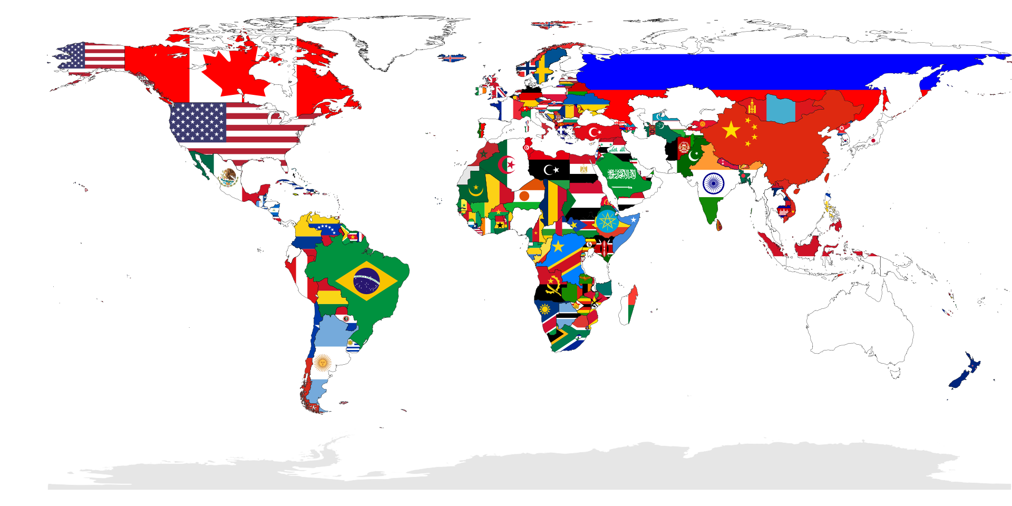
Numbering assignment: Organisation of the old world
193 UN countries

Slide 13
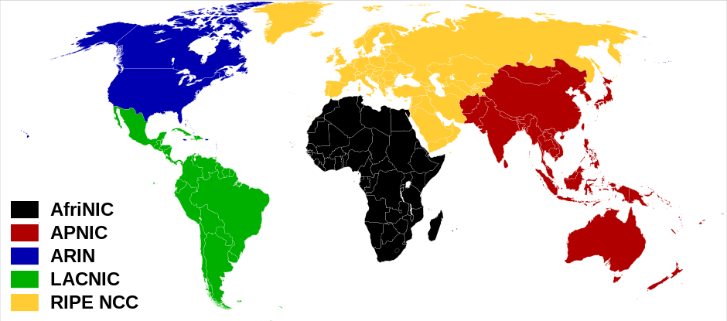
Numbering assignment: Organisation of the new world

Slide 14
Will telephone numbers ever be obselete?
“So while Facebook says one of the trends for 2016 will be the disappearance of phone numbers - and they aren't necessarily being used for calls or sending messages as much any more - it's purpose has gone through an evolution and is still being used for other things, so they might hang around for a little longer yet.”

Slide 15
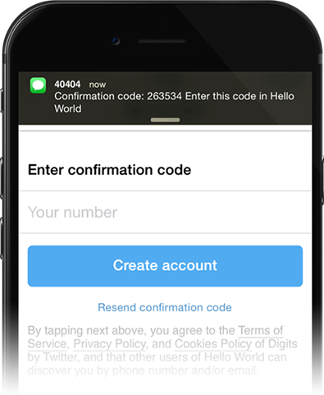
New uses for numbers – SMS Authentication
Use of SMS a pure messaging platform has declined for person-to-person communication
Its use as an authentication tool is growing for Internet payments, High security password resets and online banking
The Green Paper predicted that the main functionality of E.164 numbers would be naming in an all-IP environment.
However it is likely that E.164 numbers will continue to be used for authentication purposes for many years to come.
The value of the number to the user will become increasingly important and number portability will continue to be important for facilitating competition and protecting end-user rights.

Slide 16
Future of telephone number for routing
Preference towards using social media (facetime, facebook messenger, whatsapp, skype)
But the telephone number persists and is used differently
WG NaN Green Paper
E.164 numbers will still be the most common universal identifiers used for the provision of electronic communication services which will have to be coordinated at the national and international level (ITU-T). The main function will be naming, and the national public authorities will have to manage the resource in the interest of all stake holders.
Telephone number mapping (eNUM)
+4529673099 to 9.9.0.3.7.6.2.9.5.4.e.164.arpa
WhatsApp
+4529673099 to 4529673099@s.whatsapp.net

Slide 17
ECC Strategic Plan – Major topics for the next 5 years
Numbering and Addressing for Machine-to-Machine Communications (M2M)
The growth in M2M communications services in recent years has been dramatic and further exponential growth is foreseen in the next strategic cycle. Facilitating data exchange between objects, with or without human intervention, is the foundation on which it is possible to create many new applications and services that will have profound benefits for citizens (e.g. smart cities, smart cars, E-health services, smart metering, smart grids and eCall). E.212 and E.164 numbering resources will continue to be needed to address devices for these new and innovative services.
The ECC shall provide guidance to all relevant stakeholders on the most appropriate numbering resources to be used for M2M services. This will involve developing deliverables to remove existing barriers to providing access to these resources, to creating more capacity where necessary and to ensure that competition and innovation can thrive in this exciting new market segment.

Slide 18
By 2019, 50% of Total Connections in Europe will be M2M
Source: CISCO

Slide 19
“BUT………….M2M Traffic Only About 3% by 2019”
Source: CISCO

Slide 20
“Only 9% of all cellular connections will be M2M/IoT by 2019”
Source: Analysys Mason

Slide 21
What does this mean for numbering?
For spectrum management, the relationship between the number of connections and traffic volume is an extremely important consideration. i.e. capacity planning and network dimensioning, peak loads etc.
For numbering plan management, the relationship is not so important.
Once a number is assigned to a device it is “in use” regardless of whether it is connected or communicating.
While not all M2M devices will require numbers, some applications are likely to require significant volumes of numbers.

Slide 22
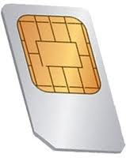
IMSI Numbers for eCall
ITU-T Recommendation E.212. defines the international identification plan for public networks and subscriptions
1,000 MCCs
100,000 MNCs overall
1,000,000,000,000,000 (10¹⁵ MSINs) A Quadrillion!
Options
Geographic MCC+MNC (assigned by National authorities)
Country-agnostic (MCC+MNC from 90x range assigned by ITU-T)
To change service provider you change SIM card.
Changing a SIM card may not be an option in the M2M environment,

Slide 23
The embedded SIM/eUICC
GSMA Specification released 2013
ETSI TC SCP
TS by end of 2016
Benefits:
Board space
Deployment in extreme environments
Economies of Scale
Avoiding operator ”lock-in”
Source: ETSI

Slide 24
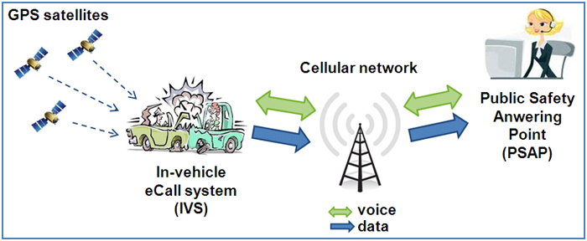
eCall – brief introduction
eCall is a European initiative intended to bring rapid assistance to motorists involved in a collision anywhere in the European Union.
By April 2018
Source: Wireless Design & Development
eCall is not optional in the EU-28. It is mandated through amendments to the type approvals directive with a confirmed implementation date.

Slide 25
eCall numbering requirements
Why do we need numbers in the first place?
eCall is essentially a mobile service
eCall needs wide geographic coverage and the ability to roam between networks
Emergency calls from “simless” devices not supported in a lot of European Countries
For network authentication and registration (including roaming) each eCall in-vehicle system needs an International Mobile Subscriber Identity Number (IMSI)
Each eCall in-vehicle system needs an telephone number (or MS-ISDN or E.164 number) to be able to make a call and present a valid CLI.
A valid CLI is needed to facilitate callback

Slide 26
eCall only V. TPS eCall + VAS
There is no business opportunity in eCall alone.
112 eCall and TPS eCall services “can coexist provided that the measures necessary to ensure continuity in the provision of the service to the consumer are adopted. “
“all vehicles should be equipped with the public 112-based eCall service, regardless of whether or not a vehicle owner opts for a TPS eCall service.”
- REGULATION (EU) 2015/758
Source: EENA

Slide 27
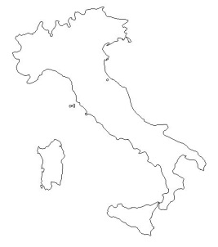
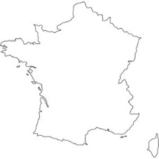
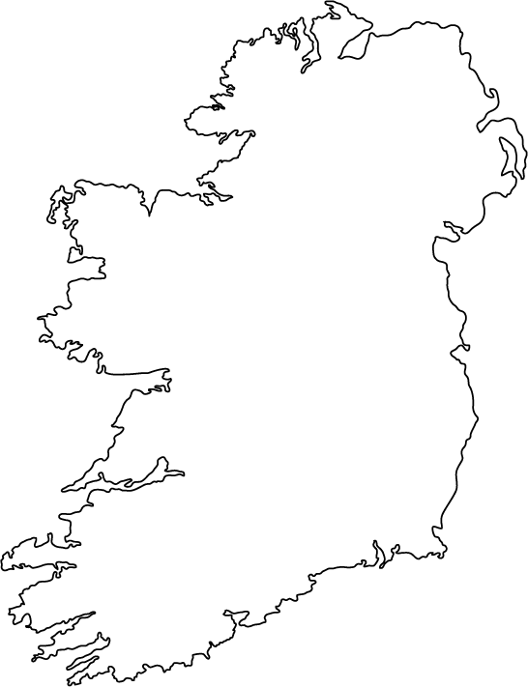
What deployment will look like with an embedded eUICC
Car Assembly Plant
Economies of Scale
In-vehicle system
embedded SIM
(eUICC-ID)
Generic Provisioning Profile
With IMSI number

Slide 28
What deployment will look like – cont’d
Option A – eCall Only
Option B – eCall+VAS
In-vehicle system
embedded UICC with generic provisioning profile
Local profile with new IMSI and telephone number download from the network.

Slide 29
Profile characteristics
eCall-only profile
Dormant – no mobility management
Privacy by design
No subscription
eCall+VAS profile
Always connected
Subscription-based service
Privacy right waived in subscription agreement
Only one profile can be active at any given time!!

Slide 30
Telephone Numbers for eCall
How many numbers required?
270 million vehicles – 5% stock renewal each year (11.5 million)
New passenger car registrations in Europe (source: ACEA)
Demand for approximately 13,000,000 new mobile telephone numbers per annum
Options
National numbers (assigned by National authorities)
Dedicated M2M numbers
Mobile numbers
International numbering resources (Assigned by ITU-T)
+882, +883 number ranges
Year | 2010 | 2011 | 2012 | 2013 | 2014 | 5 yr average
New registrations (000,000) | 13,37 | 13,15 | 12,05 | 11,87 | 12,54 | 13,2

Slide 31
Other issues
Risk of exhaustion
Biggest risk is that the burden of addressing eCall devices falls disproportionately on larger European countries.
Local profile download reduces this risk
National authorities should be engaged with MNOs and automotive industry to the lessen the risk of exhaustion.
Number recycling
Numbers recycled after a period of quarantine (typically 1 year).
No significant recycling opportunity for at least 15 years (except for accident write-offs)
Number Portability (NP)
Relevance of NP for eCall (or M2M in general) not obvious – E.164 number is used for addressing device rather than personal subscription – hidden numbers
The car manufacturer is the end user (In terms of the regulatory framework) so has a right to switch if granted rights of use.

Slide 32
Headline Work Items
PT ES | PT FNI | PT NP | PT TRIS
Harmonised implementation of A-GNSS (ECC Report to public consultation April 2016) | Extra-territorial use of E.164 numbers (ECC Recommendation for final adoption April 2016) | Facilitating switching and competition in the M2M sector. (ECC Report to public consultation November 2016) | Migration from PSTN/ISDN to All-IP networks (ECC Report to public consultation November 2016)
 | Numbering for OTT Services (ECC Report for consultation November 2016)
Future work on caller location information from IP-based networks
 | Numbering for eCall (ECC Recommendation to public consultation November 2016)

Slide 33
Thank you for your attention!
Contact:
Freddie McBride BBS MSc DipRegGov
freddie.mcbride@eco.cept.org
+45 33 89 63 22
European Communications Office:
www.cept.org/eco
Follow us on Twitter – @CEPT_ECC
4th CEPT workshop on “European Spectrum Management and Numbering”
ECO, 5 April 2016

